Slide 1
COM/BLM 376 Computer Architecture Chapter 7 Input/Output
Asst. Prof. Dr. Gazi Erkan BOSTANCI
ebostanci@ankara.edu.tr
Slides are mainly based on
Computer Organization and Architecture: Designing for Performance by William Stallings, 9th Edition, Prentice Hall

Slide 2
Outline
External Devices
I/O Modules
Programmed I/O
Interrupt-Driven I/O
Direct Memory Access

Slide 3
In addition to the processor and a set of memory modules, the third key element of a computer system is a set of I/O modules. Each module interfaces to the system bus or central switch and controls one or more peripheral devices.
An I/O module is not simply a set of mechanical connectors that wire a device into the system bus.
Rather, the I/O module contains logic for performing a communication function between the peripheral and the bus.

Slide 4
There are several reasons why the peripherals are not directly connected to the system bus:
There are a wide variety of peripherals with various methods of operation. It would be impractical to incorporate the necessary logic within the processor to control a range of devices.
The data transfer rate of peripherals is often much slower than that of the memory or processor. Thus, it is impractical to use the high-speed system bus to communicate directly with a peripheral.
On the other hand, the data transfer rate of some peripherals is faster than that of the memory or processor. Again, the mismatch would lead to inefficiencies if not managed properly.
Peripherals often use different data formats and word lengths than the computer to which they are attached.

Slide 5
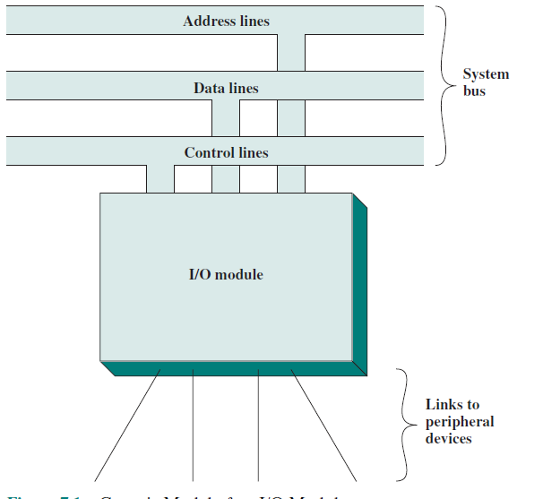
Thus, an I/O module is required. This module has two major functions
(Figure)
Interface to the processor and memory via the system bus or central switch
Interface to one or more peripheral devices by tailored data links

Slide 6
EXTERNAL DEVICES
I/O operations are accomplished through a wide assortment of external devices that provide a means of exchanging data between the external environment and the computer.
An external device attaches to the computer by a link to an I/O module . The link is used to exchange control, status, and data between the I/O module and the external device.
An external device connected to an I/O module is often referred to as a peripheral device or, simply, a peripheral.

Slide 7
We can broadly classify external devices into three categories:
Human readable: Suitable for communicating with the computer user
video display terminals (VDTs) and printers.
Machine readable: Suitable for communicating with equipment
magnetic disk and tape systems, and sensors and actuators, such as are used in a robotics application
Note that we referred to magnetic disk and tape systems as memory devices. From functional point of view, they are memory devices, but from the structural point of view, they are controlled by I/O modules.
Communication: Suitable for communicating with remote devices
Can be a human-readable device or another computer

Slide 8
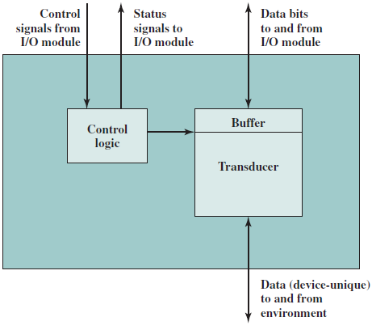
The interface to the I/O module is in the form of control, data, and status signals.
Control signals determine the function that the device will perform, such as send data to the I/O module (INPUT or READ), accept data from the I/O module (OUTPUT or WRITE), report status, or perform some control function particular to the device (e.g., position a disk head).
Data are in the form of a set of bits to be sent to or received from the I/O module.
Status signals indicate the state of the device. Examples are READY/NOT-READY to show whether the device is ready for data transfer.

Slide 9
Control logic associated with the device controls the device’s operation in response to direction from the I/O module. The transducer converts data from electrical to other forms of energy during output and from other forms to electrical during input.
Typically, a buffer is associated with the transducer to temporarily hold data being transferred between the I/O module and the external environment; a buffer size of 8 to 16 bits is common.

Slide 10
Keyboard/Monitor
The user provides input through the keyboard. This input is then transmitted to the computer and may also be displayed on the monitor. In addition, the monitor displays data provided by the computer.
The basic unit of exchange is the character. Associated with each character is a code, typically 7 or 8 bits in length. The most commonly used text code is the International Reference Alphabet (IRA). Each character in this code is represented by a unique 7-bit binary code; thus, 128 different characters can be represented.

Slide 11
Characters are of two types: printable and control.
Printable characters are the alphabetic, numeric, and special characters that can be printed on paper or displayed on a screen.
Some of the control characters have to do with controlling the printing or displaying of characters; an example is carriage return.
Other control characters are concerned with communications procedures.

Slide 12
Disk Drive
A disk drive contains electronics for exchanging data, control, and status signals with an I/O module plus the electronics for controlling the disk read/write mechanism.

Slide 13
I/O MODULES
Module Function
The major functions or requirements for an I/O module fall into the following categories:
Control and timing
Processor communication
Device communication
Data buffering
Error detection

Slide 14
During any period of time, the processor may communicate with one or more external devices in unpredictable patterns, depending on the program’s need for I/O.
The internal resources, such as main memory and the system bus, must be shared among a number of activities, including data I/O. Thus, the I/O function includes a control and timing requirement, to coordinate the flow of traffic between internal resources and external devices.

Slide 15
For example, the control of the transfer of data from an external device to the processor might involve the following sequence of steps:
The processor interrogates the I/O module to check the status of the attached device.
The I/O module returns the device status.
If the device is operational and ready to transmit, the processor requests the transfer of data, by means of a command to the I/O module.
The I/O module obtains a unit of data (e.g., 8 or 16 bits) from the external device.
The data are transferred from the I/O module to the processor.

Slide 16
If the system employs a bus, then each of the interactions between the processor and the I/O module involves one or more bus arbitrations.
The preceding simplified scenario also illustrates that the I/O module must communicate with the processor and with the external device.

Slide 17
Processor communication involves the following:
Command decoding: The I/O module accepts commands from the processor, typically sent as signals on the control bus. For example, an I/O module for a disk drive might accept the following commands: READ SECTOR, WRITE SECTOR, SEEK track number, and SCAN record ID. The latter two commands each include a parameter that is sent on the data bus.
Data: Data are exchanged between the processor and the I/O module over the data bus.
Status reporting: Because peripherals are so slow, it is important to know the status of the I/O module. For example, if an I/O module is asked to send data to the processor (read), it may not be ready to do so because it is still working on the previous I/O command. This fact can be reported with a status signal. Common status signals are BUSY and READY. There may also be signals to report various error conditions.
Address recognition: Just as each word of memory has an address, so does each I/O device. Thus, an I/O module must recognize one unique address for each peripheral it controls.

Slide 18
On the other side, the I/O module must be able to perform device communication. This communication involves commands, status information, and data.
An essential task of an I/O module is data buffering. The need for this function is apparent. Whereas the transfer rate into and out of main memory or the processor is quite high, the rate is orders of magnitude lower for many peripheral devices and covers a wide range.
Finally, an I/O module is often responsible for error detection and for subsequently reporting errors to the processor.
One class of errors includes mechanical and electrical malfunctions reported by the device (e.g., paper jam, bad disk track).
Another class consists of unintentional changes to the bit pattern as it is transmitted from device to I/O module.

Slide 19
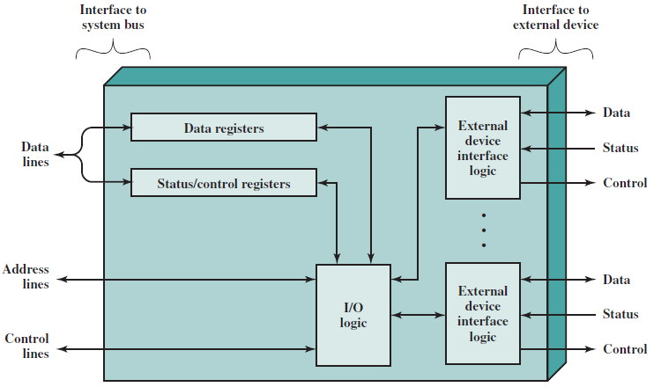
I/O Module Structure
I/O modules vary considerably in complexity and the number of external devices that they control.
Figure provides a general block diagram of an I/O module.

Slide 20
An I/O module functions to allow the processor to view a wide range of devices in a simple-minded way. There is a spectrum of capabilities that may be provided.
The I/O module may hide the details of timing, formats, and the electromechanics of an external device so that the processor can function in terms of simple read and write commands, and possibly open and close file commands.
In its simplest form, the I/O module may still leave much of the work of controlling a device (e.g., rewind a tape) visible to the processor.

Slide 21
An I/O module that takes on most of the detailed processing burden, presenting a high-level interface to the processor, is usually referred to as an I/O channel or I/O processor.
An I/O module that is quite primitive and requires detailed control is usually referred to as an I/O controller or device controller. I/O controllers are commonly seen on microcomputers, whereas I/O channels are used on mainframes.

Slide 22
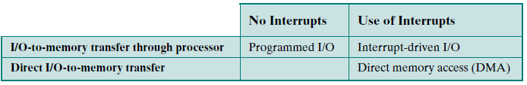
PROGRAMMED I/O
Three techniques are possible for I/O operations.

Slide 23
With programmed I/O, data are exchanged between the processor and the I/O module. The processor executes a program that gives it direct control of the I/O operation, including sensing device status, sending a read or write command, and transferring the data.
When the processor issues a command to the I/O module, it must wait until the I/O operation is complete. If the processor is faster than the I/O module, this is wasteful of processor time.

Slide 24
With interrupt-driven I/O, the processor issues an I/O command, continues to execute other instructions, and is interrupted by the I/O module when the latter has completed its work.
With both programmed and interrupt I/O, the processor is responsible for extracting data from main memory for output and storing data in main memory for input.
The alternative is known as direct memory access (DMA). In this mode, the I/O module and main memory exchange data directly, without processor involvement.

Slide 25
Overview of Programmed I/O
When the processor is executing a program and encounters an instruction relating to I/O, it executes that instruction by issuing a command to the appropriate I/O module. With programmed I/O, the I/O module will perform the requested action and then set the appropriate bits in the I/O status register (Figure above).
The I/O module takes no further action to alert the processor. In particular, it does not interrupt the processor. Thus, it is the responsibility of the processor periodically to check the status of the I/O module until it finds that the operation is complete.
Polling

Slide 26
I/O Commands
To execute an I/O-related instruction, the processor issues an address, specifying the particular I/O module and external device, and an I/O command. There are four types of I/O commands that an I/O module may receive when it is addressed by a processor:
Control: Used to activate a peripheral and tell it what to do. For example, a magnetic-tape unit may be instructed to rewind or to move forward one record. These commands are tailored to the particular type of peripheral device.
Test: Used to test various status conditions associated with an I/O module and its peripherals. The processor will want to know that the peripheral of interest is powered on and available for use. It will also want to know if the most recent I/O operation is completed and if any errors occurred.
Read: Causes the I/O module to obtain an item of data from the peripheral and place it in an internal buffer (depicted as a data register in Figure above). The processor can then obtain the data item by requesting that the I/O module place it on the data bus.
Write: Causes the I/O module to take an item of data (byte or word) from the data bus and subsequently transmit that data item to the peripheral.

Slide 27
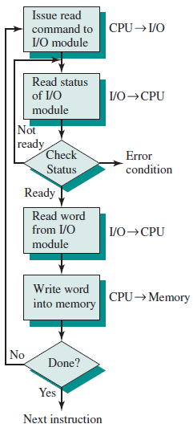
Figure gives an example of the use of programmed I/O to read in a block of data from a peripheral device (e.g., a record from tape) into memory. Data are read in one word (e.g., 16 bits) at a time.
For each word that is read in, the processor must remain in a status-checking cycle until it determines that the word is available in the I/O module’s data register.
This flowchart highlights the main disadvantage of this technique: it is a time-consuming process that keeps the processor busy needlessly.

Slide 28
I/O Instructions
With programmed I/O, there is a close correspondence between the I/O-related instructions that the processor fetches from memory and the I/O commands that the processor issues to an I/O module to execute the instructions.
That is, the instructions are easily mapped into I/O commands, and there is often a simple one-to-one relationship. The form of the instruction depends on the way in which external devices are addressed.

Slide 29
Typically, there will be many I/O devices connected through I/O modules to the system. Each device is given a unique identifier or address.
When the processor issues an I/O command, the command contains the address of the desired device. Thus, each I/O module must interpret the address lines to determine if the command is for itself.

Slide 30
When the processor, main memory, and I/O share a common bus, two modes of addressing are possible:
memory mapped and
isolated.
With memory-mapped I/O, there is a single address space for memory locations and I/O devices. The processor treats the status and data registers of I/O modules as memory locations and uses the same machine instructions to access both memory and I/O devices.
So, for example, with 10 address lines, a combined total of 2¹⁰ = 1024 memory locations and I/O addresses can be supported, in any combination.

Slide 31
With memory-mapped I/O, a single read line and a single write line are needed on the bus.
Alternatively, the bus may be equipped with memory read and write plus input and output command lines. Now, the command line specifies whether the address refers to a memory location or an I/O device.
MRC, MWC, IORC, IOWC
The full range of addresses may be available for both. Again, with 10 address lines, the system may now support both 1024 memory locations and 1024 I/O addresses. Because the address space for I/O is isolated from that for memory, this is referred to as isolated I/O.

Slide 32
Figure below contrasts these two programmed I/O techniques. Figure (a) shows how the interface for a simple input device such as a terminal keyboard might appear to a programmer using memory-mapped I/O. Assume a 10-bit address, with a 512- bit memory (locations 0–511) and up to 512 I/O addresses (locations 512–1023).
Two addresses are dedicated to keyboard input from a particular terminal. Address 516 refers to the data register and address 517 refers to the status register, which also functions as a control register for receiving processor commands. The program shown will read 1 byte of data from the keyboard into an accumulator register in the processor. Note that the processor loops until the data byte is available.
With isolated I/O (Figure (b)), the I/O ports are accessible only by special I/O commands, which activate the I/O command lines on the bus.

Slide 33
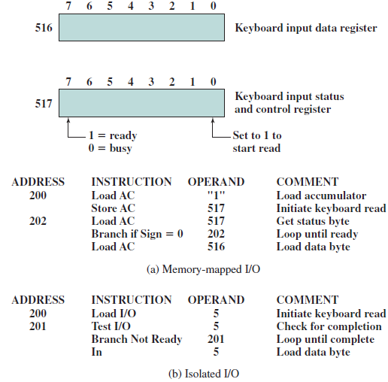

Slide 34
For most types of processors, there is a relatively large set of different instructions for referencing memory. If isolated I/O is used, there are only a few I/O instructions.
Thus, an advantage of memory-mapped I/O is that this large repertoire of instructions can be used, allowing more efficient programming.
A disadvantage is that valuable memory address space is used up. Both memory-mapped and isolated I/O are in common use.

Slide 35
INTERRUPT DRIVEN I/O
The problem with programmed I/O is that the processor has to wait a long time for the I/O module of concern to be ready for either reception or transmission of data. The processor, while waiting, must repeatedly interrogate the status of the I/O module. As a result, the level of the performance of the entire system is severely degraded.
An alternative is for the processor to issue an I/O command to a module and then go on to do some other useful work. The I/O module will then interrupt the processor to request service when it is ready to exchange data with the processor. The processor then executes the data transfer, as before, and then resumes its former processing.

Slide 36
Let us consider how this works, first from the point of view of the I/O module.
For input, the I/O module receives a READ command from the processor. The I/O module then proceeds to read data in from an associated peripheral.
Once the data are in the module’s data register, the module signals an interrupt to the processor over a control line. The module then waits until its data are requested by the processor. When the request is made, the module places its data on the data bus and is then ready for another I/O operation.

Slide 37
From the processor’s point of view, the action for input is as follows. The processor issues a READ command. It then goes off and does something else
(e.g., the processor may be working on several different programs at the same time).
At the end of each instruction cycle, the processor checks for interrupts. When the interrupt from the I/O module occurs, the processor saves the context (e.g., program counter and processor registers) of the current program and processes the interrupt.
In this case, the processor reads the word of data from the I/O module and stores it in memory. It then restores the context of the program it was working on (or some other program) and resumes execution.

Slide 38
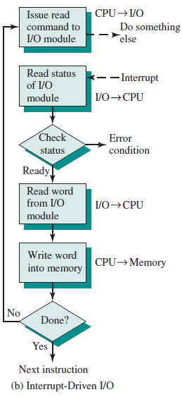
Figure shows the use of interrupt I/O for reading in a block of data.
Compare this with the figure for programmed I/O. Interrupt I/O is more efficient than programmed I/O because it eliminates needless waiting.
However, interrupt I/O still consumes a lot of processor time, because every word of data that goes from memory to I/O module or from I/O module to memory must pass through the processor.

Slide 39
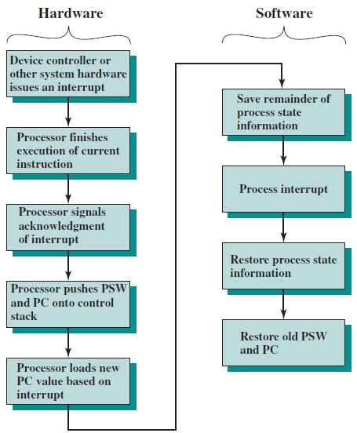
Interrupt Processing
The occurrence of an interrupt triggers a number of events, both in the processor hardware and in software.
Figure shows a typical sequence.

Slide 40
When an I/O device completes an I/O operation, the following sequence of hardware events occurs:
The device issues an interrupt signal to the processor.
The processor finishes execution of the current instruction before responding to the interrupt.
The processor tests for an interrupt, determines that there is one, and sends an acknowledgment signal to the device that issued the interrupt. The acknowledgment allows the device to remove its interrupt signal.
The processor now needs to prepare to transfer control to the interrupt routine. To begin, it needs to save information needed to resume the current program at the point of interrupt. The minimum information required is
the status of the processor, which is contained in a register called the program status word (PSW), and
the location of the next instruction to be executed, which is contained in the program counter. These can be pushed onto the system control stack.

Slide 41
The processor now loads the program counter with the entry location of the interrupt-handling program that will respond to this interrupt.
Interrupt Service Routine
Depending on the computer architecture and operating system design, there may be a single program; one program for each type of interrupt; or one program for each device and each type of interrupt.
If there is more than one interrupt-handling routine, the processor must determine which one to invoke. This information may have been included in the original interrupt signal, or the processor may have to issue a request to the device that issued the interrupt to get a response that contains the needed information.
At this point, the program counter and PSW relating to the interrupted program have been saved on the system stack. However, there is other information that is considered part of the “state” of the executing program. In particular, the contents of the processor registers need to be saved, because these registers may be used by the interrupt handler. So, all of these values, plus any other state information, need to be saved. Typically, the interrupt handler will begin by saving the contents of all registers on the stack.

Slide 42
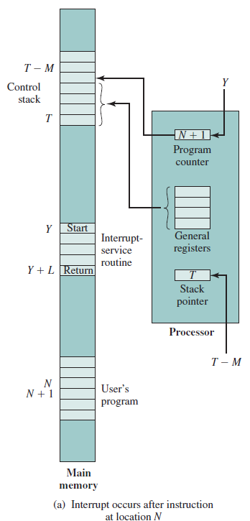
Figure shows a simple example. In this case, a user program is interrupted after the instruction at location N.
The contents of all of the registers plus the address of the next instruction (N + 1) are pushed onto the stack.
The stack pointer is updated to point to the new top of stack, and the program counter is updated to point to the beginning of the interrupt service routine.

Slide 43
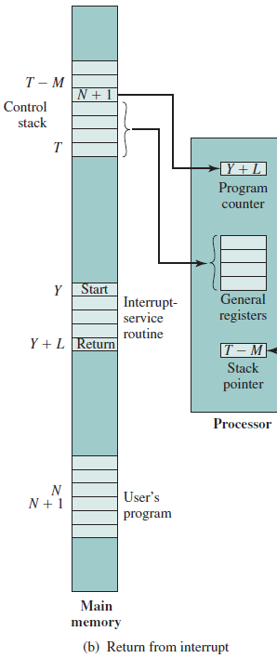
The interrupt handler next processes the interrupt. This includes an examination of status information relating to the I/O operation or other event that caused an interrupt. It may also involve sending additional commands or acknowledgments to the I/O device.
When interrupt processing is complete, the saved register values are retrieved from the stack and restored to the registers (e.g., see Figure).
The final act is to restore the PSW and program counter values from the stack. As a result, the next instruction to be executed will be from the previously interrupted program.

Slide 44
Note that it is important to save all the state information about the interrupted program for later resumption. This is because the interrupt is not a routine called from the program. Rather, the interrupt can occur at any time and therefore at any point in the execution of a user program.
Its occurrence is unpredictable.
Indeed, as we will see in the next chapter, the two programs may not have anything in common and may belong to two different users.

Slide 45
Design Issues
Two design issues arise in implementing interrupt I/O.
First, because there will almost invariably be multiple I/O modules, how does the processor determine which device issued the interrupt?
And second, if multiple interrupts have occurred, how does the processor decide which one to process?

Slide 46
Let us consider device identification first. Four general categories of techniques are in common use:
Multiple interrupt lines
Software poll
Daisy chain (hardware poll, vectored)
Bus arbitration (vectored)

Slide 47
The most straightforward approach to the problem is to provide multiple interrupt lines between the processor and the I/O modules.
However, it is impractical to dedicate more than a few bus lines or processor pins to interrupt lines.
Consequently, even if multiple lines are used, it is likely that each line will have multiple I/O modules attached to it. Thus, one of the other three techniques must be used on each line.

Slide 48
One alternative is the software poll. When the processor detects an interrupt, it branches to an interrupt-service routine whose job it is to poll each I/O module to determine which module caused the interrupt.
The poll could be in the form of a separate command line (e.g., TESTI/O). In this case, the processor raises TESTI/O and places the address of a particular I/O module on the address lines.
The I/O module responds positively if it sets the interrupt.
Alternatively, each I/O module could contain an addressable status register. The processor then reads the status register of each I/O module to identify the interrupting module. Once the correct module is identified, the processor branches to a device-service routine specific to that device.

Slide 49
The disadvantage of the software poll is that it is time consuming. A more efficient technique is to use a daisy chain, which provides, in effect, a hardware poll.
For interrupts, all I/O modules share a common interrupt request line. The interrupt acknowledge line is daisy chained through the modules. When the processor senses an interrupt, it sends out an interrupt acknowledge.
This signal propagates through a series of I/O modules until it gets to a requesting module. The requesting module typically responds by placing a word on the data lines. This word is referred to as a vector and is either the address of the I/O module or some other unique identifier.
In either case, the processor uses the vector as a pointer to the appropriate device-service routine. This avoids the need to execute a general interrupt-service routine first. This technique is called a vectored interrupt.

Slide 50
There is another technique that makes use of vectored interrupts, and that is bus arbitration. With bus arbitration, an I/O module must first gain control of the bus before it can raise the interrupt request line.
Thus, only one module can raise the line at a time. When the processor detects the interrupt, it responds on the interrupt acknowledge line. The requesting module then places its vector on the data lines.

Slide 51
The aforementioned techniques serve to identify the requesting I/O module. They also provide a way of assigning priorities when more than one device is requesting interrupt service.
With multiple lines, the processor just picks the interrupt line with the highest priority.
With software polling, the order in which modules are polled determines their priority. Similarly, the order of modules on a daisy chain determines their priority.
Finally, bus arbitration can employ a priority scheme: centralized or distributed.

Slide 52
Intel 82C59A Interrupt Controller
The Intel 80386 provides a single Interrupt Request (INTR) and a single Interrupt Acknowledge (INTA) line.
To allow the 80386 to handle a variety of devices and priority structures, it is usually configured with an external interrupt arbiter, the 82C59A.
External devices are connected to the 82C59A, which in turn connects to the 80386.

Slide 53
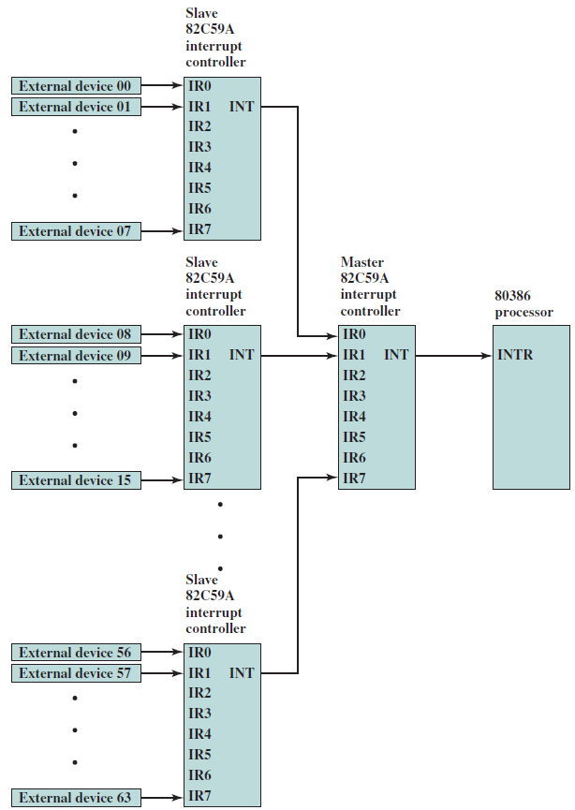
Figure shows the use of the 82C59A to connect multiple I/O modules for the 80386.
A single 82C59A can handle up to eight modules. If control for more than eight modules is required, a cascade arrangement can be used to handle up to 64 modules.

Slide 54
The 82C59A’s sole responsibility is the management of interrupts. It accepts interrupt requests from attached modules, determines which interrupt has the highest priority, and then signals the processor by raising the INTR line.
The processor acknowledges via the INTA line. This prompts the 82C59A to place the appropriate vector information on the data bus. The processor can then proceed to process the interrupt and to communicate directly with the I/O module to read or write data.

Slide 55
The Intel 82C55A Programmable Peripheral Interface
As an example of an I/O module used for programmed I/O and interrupt-driven I/O, we consider the Intel 82C55A Programmable Peripheral Interface.
The 82C55A is a single-chip, general-purpose I/O module designed for use with the Intel 80386 processor.

Slide 56
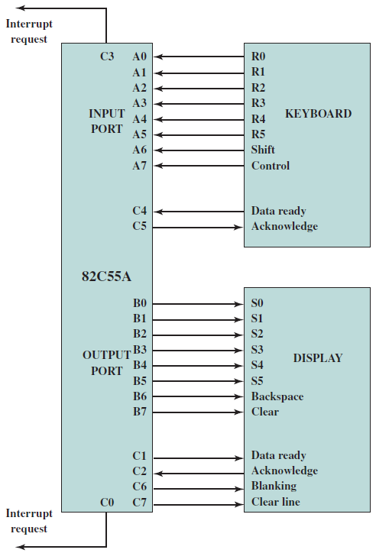
Figure illustrates its use to control a keyboard/display terminal. The keyboard provides 8 bits of input. Two of these bits, SHIFT and CONTROL, have special meaning to the keyboard-handling program executing in the processor. However, this interpretation is transparent to the 82C55A, which simply accepts the 8 bits of data and presents them on the system data bus.
Two handshaking control lines are provided for use with the keyboard.
The display is also linked by an 8-bit data port. Again, two of the bits have special meanings that are transparent to the 82C55A. In addition to two handshaking lines, two lines provide additional control functions.

Slide 57
DIRECT MEMORY ACCESS
Drawbacks of Programmed and Interrupt-Driven I/O
Interrupt-driven I/O, though more efficient than simple programmed I/O, still requires the active intervention of the processor to transfer data between memory and an I/O module, and any data transfer must traverse a path through the processor.
Thus, both these forms of I/O suffer from two inherent drawbacks:
The I/O transfer rate is limited by the speed with which the processor can test and service a device.
The processor is tied up in managing an I/O transfer; a number of instructions must be executed for each I/O transfer

Slide 58
There is somewhat of a trade-off between these two drawbacks.
Consider the transfer of a block of data. Using simple programmed I/O, the processor is dedicated to the task of I/O and can move data at a rather high rate, at the cost of doing nothing else.
Interrupt I/O frees up the processor to some extent at the expense of the I/O transfer rate. Nevertheless, both methods have an adverse impact on both processor activity and I/O transfer rate.
When large volumes of data are to be moved, a more efficient technique is required: direct memory access (DMA).

Slide 59
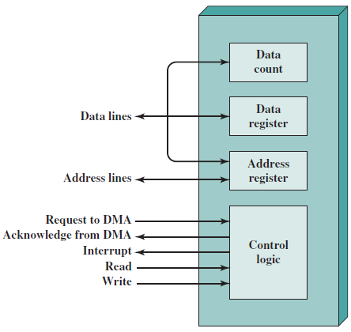
DMA Function
DMA involves an additional module on the system bus. The DMA module (Figure) is capable of mimicking the processor and, indeed, of taking over control of the system from the processor. It needs to do this to transfer data to and from memory over the system bus.
For this purpose, the DMA module must use the bus only when the processor does not need it, or it must force the processor to suspend operation temporarily.
The latter technique is more common and is referred to as cycle stealing, because the DMA module in effect steals a bus cycle.

Slide 60
When the processor wishes to read or write a block of data, it issues a command to the DMA module, by sending to the DMA module the following information:
Whether a read or write is requested, using the read or write control line between the processor and the DMA module
The address of the I/O device involved, communicated on the data lines
The starting location in memory to read from or write to, communicated on the data lines and stored by the DMA module in its address register
The number of words to be read or written, again communicated via the data lines and stored in the data count register

Slide 61
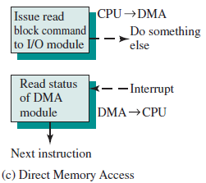
The processor then continues with other work. It has delegated this I/O operation to the DMA module. The DMA module transfers the entire block of data, one word at a time, directly to or from memory, without going through the processor.
When the transfer is complete, the DMA module sends an interrupt signal to the processor. Thus, the processor is involved only at the beginning and end of the transfer (Figure).

Slide 62
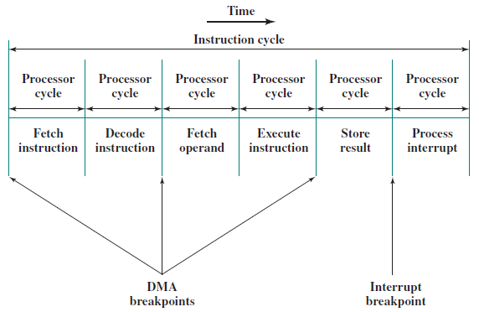
Figure shows where in the instruction cycle the processor may be suspended.
In each case, the processor is suspended just before it needs to use the bus. The DMA module then transfers one word and returns control to the processor.
Note that this is not an interrupt; the processor does not save a context and do something else. Rather, the processor pauses for one bus cycle. The overall effect is to cause the processor to execute more slowly. Nevertheless, for a multiple-word I/O transfer, DMA is far more efficient than interrupt-driven or programmed I/O.

Slide 63
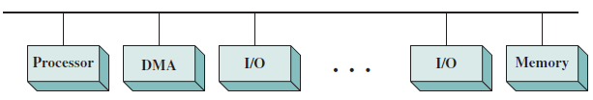
The DMA mechanism can be configured in a variety of ways. Figure shows one where all modules sharing the same system bus. The DMA module, acting as a surrogate processor, uses programmed I/O to exchange data between memory and an I/O module through the DMA module.
This configuration, while it may be inexpensive, is clearly inefficient. As with processor-controlled programmed I/O, each transfer of a word consumes two bus cycles.
Single bus, detached DMA

Slide 64
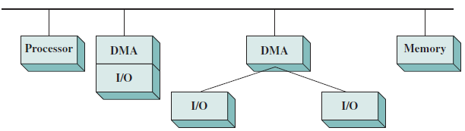
The number of required bus cycles can be cut substantially by integrating the DMA and I/O functions. As figure indicates, this means that there is a path between the DMA module and one or more I/O modules that does not include the system bus.
The DMA logic may actually be a part of an I/O module, or it may be a separate module that controls one or more I/O modules.
Single-bus, integrated DMA-I/O

Slide 65
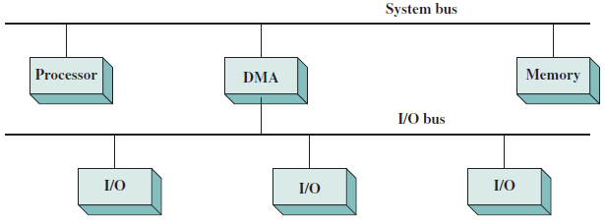
The I/O modules can be connected to the DMA module using an I/O bus. This reduces the number of I/O interfaces in the DMA module to one and provides for an easily expandable configuration.
I/O bus

Slide 66
In the last two cases, the system bus that the DMA module shares with the processor and memory is used by the DMA module only to exchange data with memory.
The exchange of data between the DMA and I/O modules takes place off the system bus.

Slide 67
Intel 8237A DMA Controller
The Intel 8237A DMA controller interfaces to the 80x86 family of processors and to DRAM memory to provide a DMA capability. Figure below indicates the location of the DMA module. When the DMA module needs to use the system buses (data, address, and control) to transfer data, it sends a signal called HOLD to the processor.
The processor responds with the HLDA (hold acknowledge) signal, indicating that the DMA module can use the buses.

Slide 68
